Slide 1
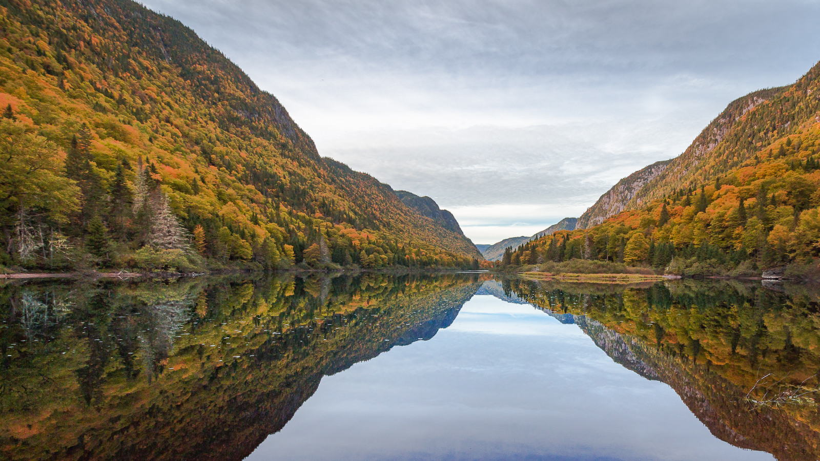
What does water quality mean to you?
Nicolas Fortin St-Gelais, Jean-Francois Lapierre, Jean-Olivier Goyette & Roxane Maranger
Université de Montréal
Crédit photo: Laurent Gass
Notes:
Origine de l’idée

Slide 2
La vision de la qualité de l’eau...
avec la lentille de google news
Water quality =
Recherche sur google news le 2018-03-19 (n=30)

Slide 3
La vision de la qualité de l’eau...
avec la lentille de google news
Baignade
Water quality =
Status trophique
Protection de la faune
Recherche sur google news le 2018-03-19 (n=30)

Slide 4
La vision de la qualité de l’eau...
avec la lentille de google news
Eau potable
Baignade
Water quality =
Status trophique
Protection de la faune
Recherche sur google news le 2018-03-19 (n=30)

Slide 5
La vision de la qualité de l’eau...
avec la lentille de google news
Eau potable
Indices composés
Baignade
Water quality =
Status trophique
Protection de la faune
Recherche sur google news le 2018-03-19 (n=30)

Slide 6
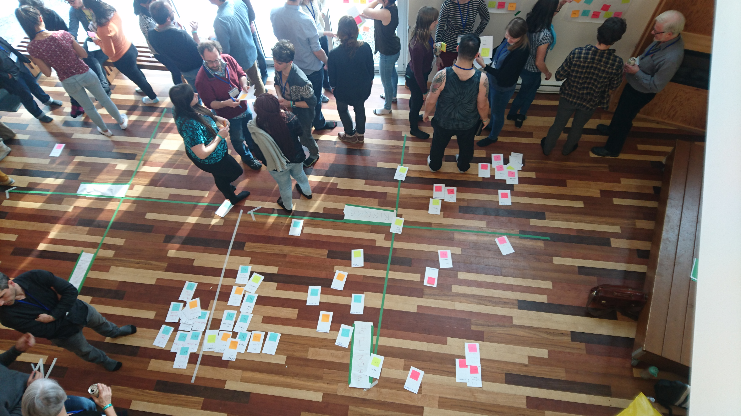
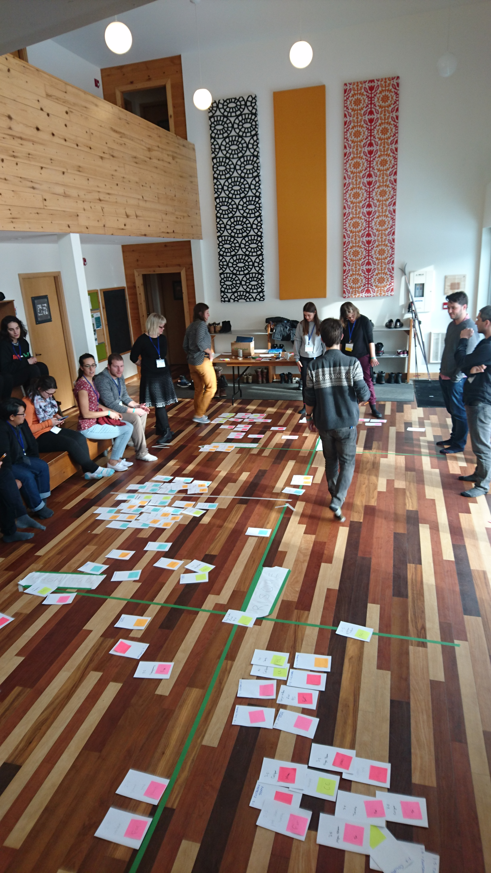
La vision de la qualité de l’eau...
Pour des limnogistes

Slide 7
La vision de la qualité de l’eau...
Pour des limnogistes
Water quality =
Contamination fécale
Status trophique
Dureté de l’eau
Eau potale
Protection faune
Recherche sur google news le 2018-03-19 (n=30)

Slide 8
La vision de la qualité de l’eau...
Pour des limnogistes
Pollution
Qualités
Esthétiques
Turbidité
Cyanobactéries
Water quality =
Contamination fécale
Status trophique
Dureté de l’eau
Eau potale
Protection faune
Recherche sur google news le 2018-03-19 (n=30)

Slide 9
“Water quality is a term used to express the suitability of water to sustain various uses or processes. […]”
(UNEP/WHO)
Niveau
Trophique
Irrigation
Potable
Icon made by Pixel Perfect
Notes:
Putting together the two views with the definition of water quality it is clear that wq is a complex concept with many different aspects
It is probably my community ecologist bias but I always like to think in term of a space, and water quality can be concived as a space with different aspects

Slide 10
“Water quality is a term used here to express the suitability of water to sustain various uses or processes. […]”
(UNEP/WHO)
Niveau
Trophique
Qualité de l’eau
Irrigation
Potable
Icon made by Pixel Perfect
Notes:
Putting together the two views with the definition of water quality it is clear that wq is a complex concept with many different aspects
It is probably my community ecologist bias but I always like to think in term of a space, and water quality can be concived as a space with different aspects

Slide 11
World views
Ecoservices
Metrics
Public health
(e.g. drinking, swimming)
Drinking
Livestock
Irrigation
Swimming
Aesthetic
Industrial
(e.g. livestock, irrigation)
Water
Quality
Ecological
(e.g. Eutrophication)
Heavy metals
Pesticides
Fecal contamination
Eutrophication
Recreational
Notes:
Putting together the two views with the definition of water quality it is clear that wq is a complex concept with many different aspects
It is probably my community ecologist bias but I always like to think in term of a space, and water quality can be concived as a space with different aspects

Slide 12
Public health
Industrial
Recreational
Ecological
World views
Ecoservices
(drinking, swimming)
livestock, irrigation
Wildlife protection
Swimming
trophic status
Pestices, metals,
microbiological
Pestices, metals,
Other organic chemicals
microbiological
Metrics
Pestices, metals,
Other organic chemicals
microbiological
Nutrients
&microbiological
Perspective
Organismal
Organismal
Organismal
Ecosystemic
Notes:
Putting together the two views with the definition of water quality it is clear that wq is a complex concept with many different aspects
It is probably my community ecologist bias but I always like to think in term of a space, and water quality can be concived as a space with different aspects

Slide 13

Mission:
Évaluer la vulnérabilité des services rendus par les lacs aux changements climatiques et dans l’utilisation du territoire.
Δ climat
Δ LU
Notes:
This is a project that is a component of lake pulse, we want to understand the vulnerability of the different wq aspects

Slide 14
“Water quality is a term used here to express the suitability of water to sustain various uses or processes. […] water quality can be defined by a range of variables which limit water use.”
(UNEP/WHO)
Niveau
Trophique
Qualité de l’eau
Irrigation
Potable
Icon made by Pixel Perfect
Notes:
How do we define a world view? = criteria

Slide 15
Exploration des critères de qualité de l’eau
Organic chemical
Inorganic chemical
Pesticide
Biological
Disinfectant
Metal
Physical
Nutrients
pH
Quel est le chevauchement entre les critères de qualité de l’eau?
Irrigation
0.4
0.4
0.1
0.1
0
0
0
0
0
Livestock
0.5
0.3
0
0.2
0.1
0
0
0
0
Drinking
0.3
0.1
0.1
0.3
0.1
0.1
0
0
0
Aquatic wildlife
0.3
0.2
0
0.5
0
0
0
0
0
Recreation
0
0
0.3
0
0
0
0.3
0.3
0
Trophic Status
0
0
0.2
0
0
0
0
0
0.8

Slide 16
Exploration des critères de qualité de l’eau
Organic chemical
Inorganic chemical
Pesticide
Biological
Disinfectant
Metal
Physical
Nutrients
pH
Quel est le chevauchement entre les critères de qualité de l’eau?
Irrigation
0.4
0.4
0.1
0.1
0
0
0
0
0
Livestock
0.5
0.3
0
0.2
0.1
0
0
0
0
Drinking
0.3
0.1
0.1
0.3
0.1
0.1
0
0
0
Aquatic wildlife
0.3
0.2
0
0.5
0
0
0
0
0
Recreation
0
0
0.3
0
0
0
0.3
0.3
0
Trophic Status
0
0
0.2
0
0
0
0
0
0.8

Slide 17
Exploration des critères de qualité de l’eau
Organic chemical
Inorganic chemical
Pesticide
Biological
Disinfectant
Metal
Physical
Nutrients
pH
Quel est le chevauchement entre les critères de qualité de l’eau?
Irrigation
0.4
0.4
0.1
0.1
0
0
0
0
0
Livestock
0.5
0.3
0
0.2
0.1
0
0
0
0
Drinking
0.3
0.1
0.1
0.3
0.1
0.1
0
0
0
Aquatic wildlife
0.3
0.2
0
0.5
0
0
0
0
0
Recreation
0
0
0.3
0
0
0
0.3
0.3
0
Trophic Status
0
0
0.2
0
0
0
0
0
0.8

Slide 18
Exploration des critères de qualité de l’eau
Organic chemical
Inorganic chemical
Pesticide
Biological
Disinfectant
Metal
Physical
Nutrients
pH
Quel est le chevauchement entre les critères de qualité de l’eau?
Irrigation
0.4
0.4
0.1
0.1
0
0
0
0
0
Livestock
0.5
0.3
0
0.2
0.1
0
0
0
0
Drinking
0.3
0.1
0.1
0.3
0.1
0.1
0
0
0
Aquatic wildlife
0.3
0.2
0
0.5
0
0
0
0
0
Recreation
0
0
0.3
0
0
0
0.3
0.3
0
Trophic Status
0
0
0.2
0
0
0
0
0
0.8

Slide 19
Exploration des critères de qualité de l’eau
Organic chemical
Inorganic chemical
Pesticide
Biological
Disinfectant
Metal
Physical
Nutrients
pH
Les métriques ne permettent pas de concilier les différentes visions de la qualité de l’eau
Niveau
Trophique
Irrigation
0.4
0.4
0.1
0.1
0
0
0
0
0
Livestock
0.5
0.3
0
0.2
Irrigation
0.1
0
0
0
0
Drinking
0.3
0.1
0.1
0.3
0.1
0.1
0
0
0
0.3
0.2
0
Potable
Aquatic wildlife
0.5
0
0
0
0
0
Recreation
0
0
0.3
0
0
0
0.3
0.3
0
Trophic Status
0
0
0.2
0
0
0
0
0
0.8

Slide 20
“Water quality is a term used here to express the suitability of water to sustain various uses or processes. […] water quality can be defined by a range of variables which limit water use.”
(UNEP/WHO)
Niveau
Trophique
Données?
Irrigation
Potable
Icon made by Pixel Perfect
Notes:
How do we define a world view? = criteria

Slide 21
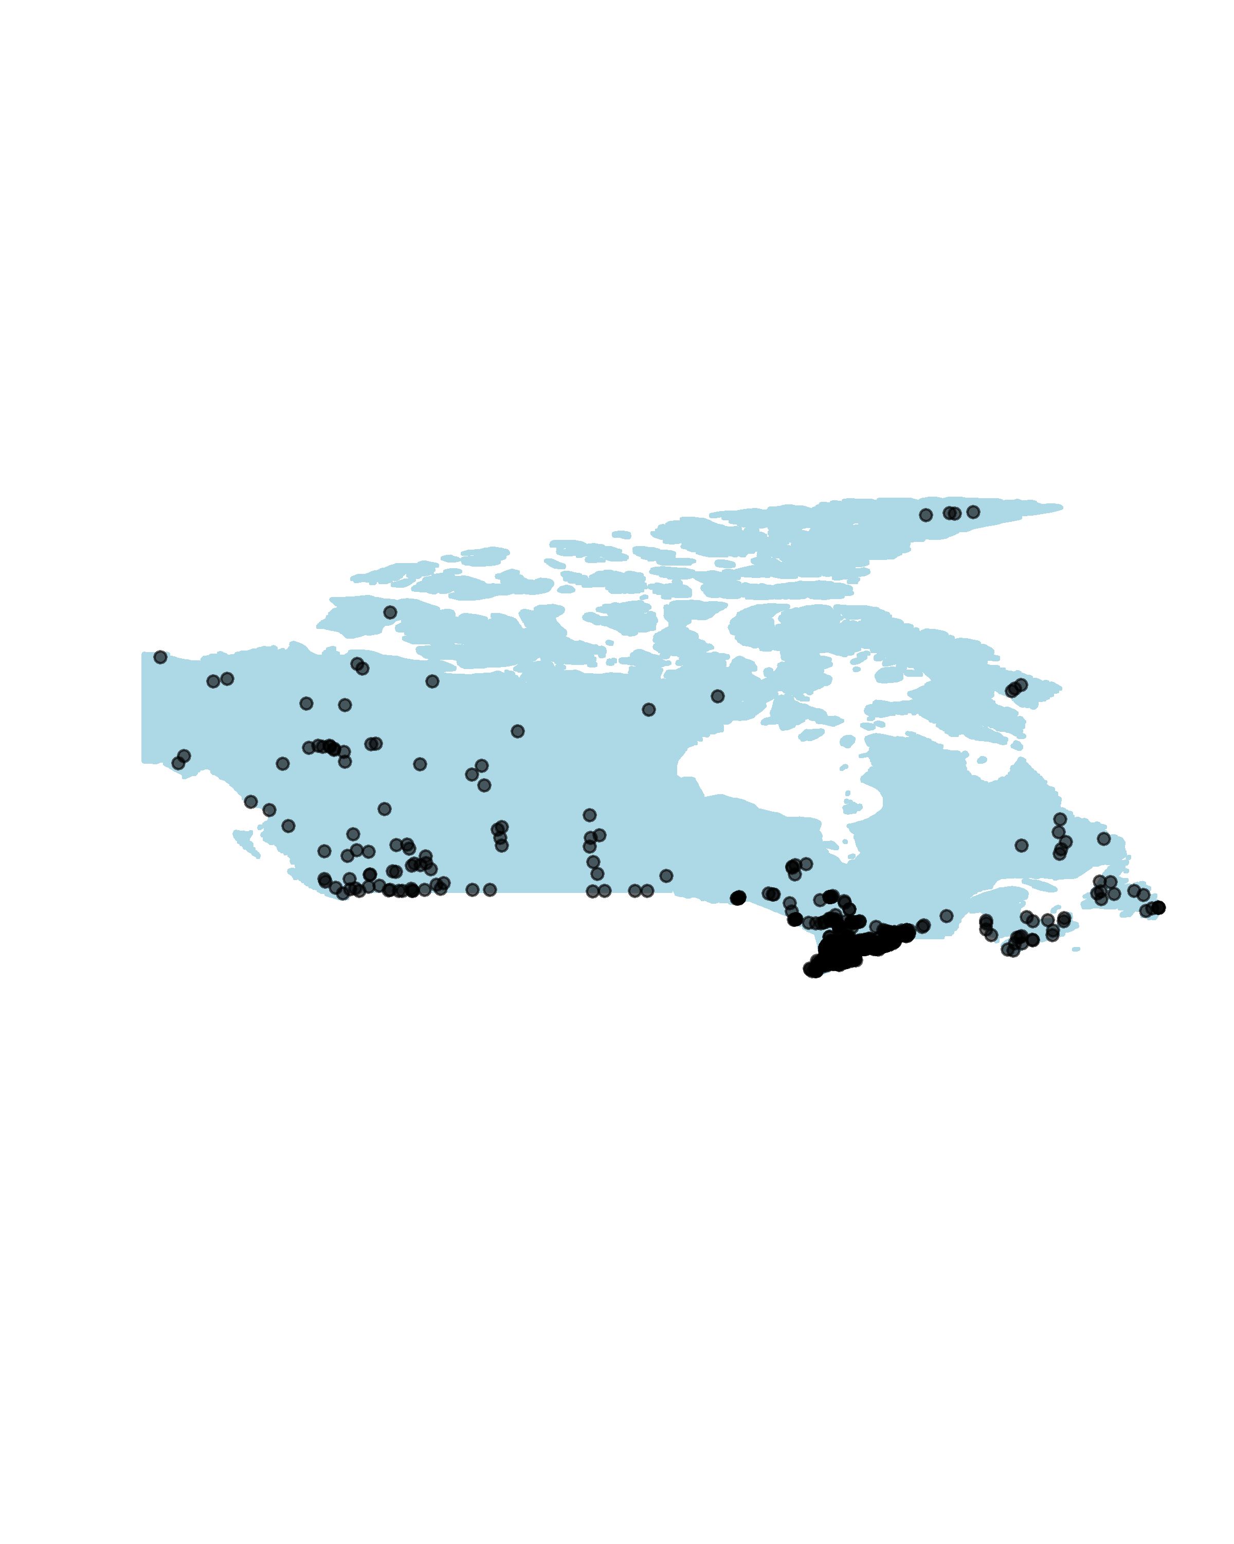
Méthodologie
758 sites à travers le Canada sur 17 ans pour un total de
61 000 échantillons

Slide 22
Quel est le chevauchement entre les différents espaces de qualité de l’eau?
 | oligotrophic | aquatic | recreational | drink | irrigation | livestock
oligotrophic | 0.44 | 0.47 | 0.74 | 0.98 | 0.97 | 1
aquatic | 0.56 | 0.37 | 0.7 | 0.99 | 0.96 | 1
recreational | 0.43 | 0.23 | 0.58 | 0.95 | 0.71 | 1
drink | 0.44 | 0.37 | 0.58 | 0.98 | 0.93 | 1
irrigation | 0.48 | 0.23 | 1 | 0.98 | 0.92 | 1
livestock | 0.44 | 0.36 | 0.58 | 0.98 | 0.92 | 1

Slide 23
Quel est le chevauchement entre les différents espaces de qualité de l’eau?
 | oligotrophic | mesotrophic | eutrophic | aquatic | recreational | drink | irrigation | livestock | DOC
oligotrophic | 0.49 | 0 | 0 | 0.45 | 0.99 | 0.37 | 1 | 1 | 0.93
mesotrophic | 0 | 0.19 | 0 | 0.11 | 0.93 | 0.61 | 0.99 | 1 | 0.76
eutrophic | 0 | 0 | 0.17 | 0.04 | 0.6 | 0.42 | 0.91 | 1 | 0.59
aquatic | 0.83 | 0.08 | 0.02 | 0.26 | 0.99 | 0.21 | 1 | 1 | 0.93
recreational | 0.62 | 0.13 | 0.12 | 0.41 | 0.9 | 0 | 1 | 1 | 0.84
drink | 0.4 | 0.26 | 0.16 | 0.12 | 1 | 0.43 | 0.99 | 1 | 0.87
irrigation | 0.5 | 0.19 | 0.16 | 0.25 | 0.93 | 0.44 | 0.97 | 1 | 0.85
livestock | 0.49 | 0.19 | 0.17 | 0.26 | 0.9 | 0.45 | 0.97 | 1 | 0.85
DOC | 0.54 | 0.17 | 0.12 | 0.29 | 0.92 | 0.45 | 0.98 | 1 | 0.84

Slide 24
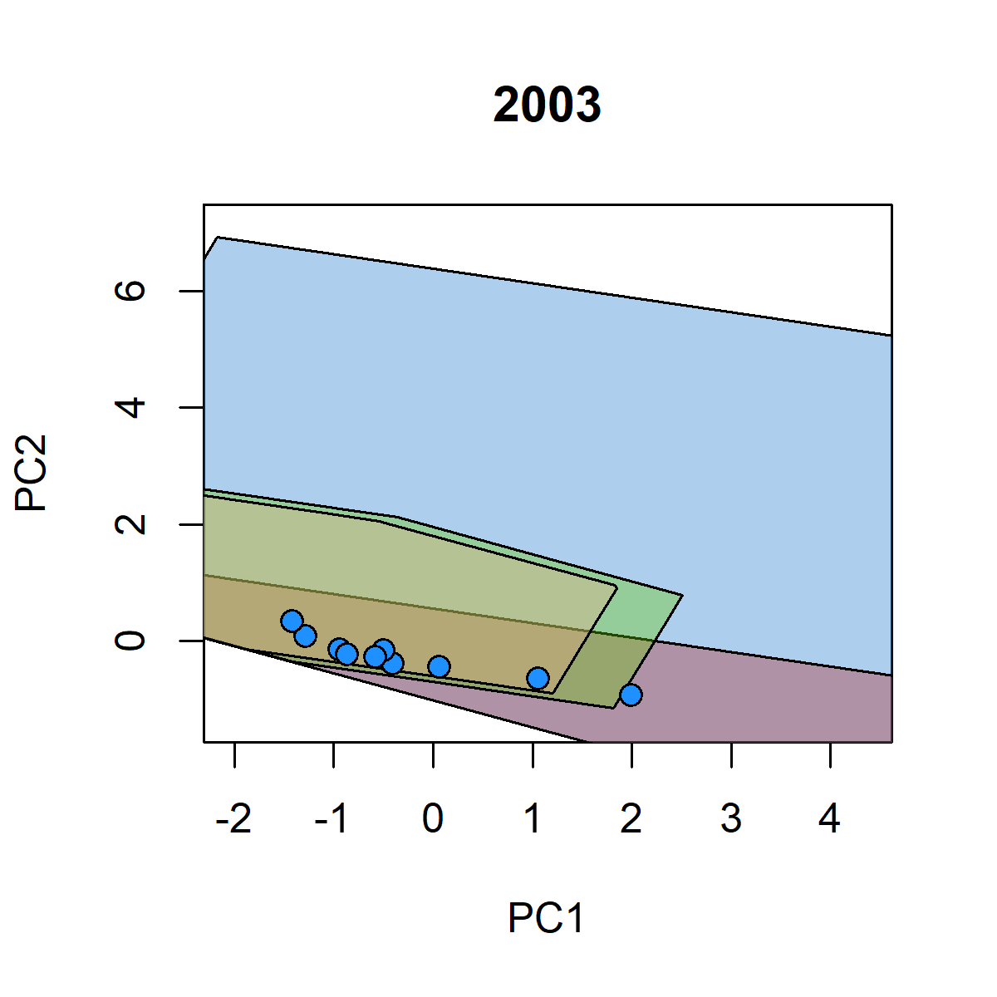
Fraser river

Slide 25

Fraser river

Slide 26
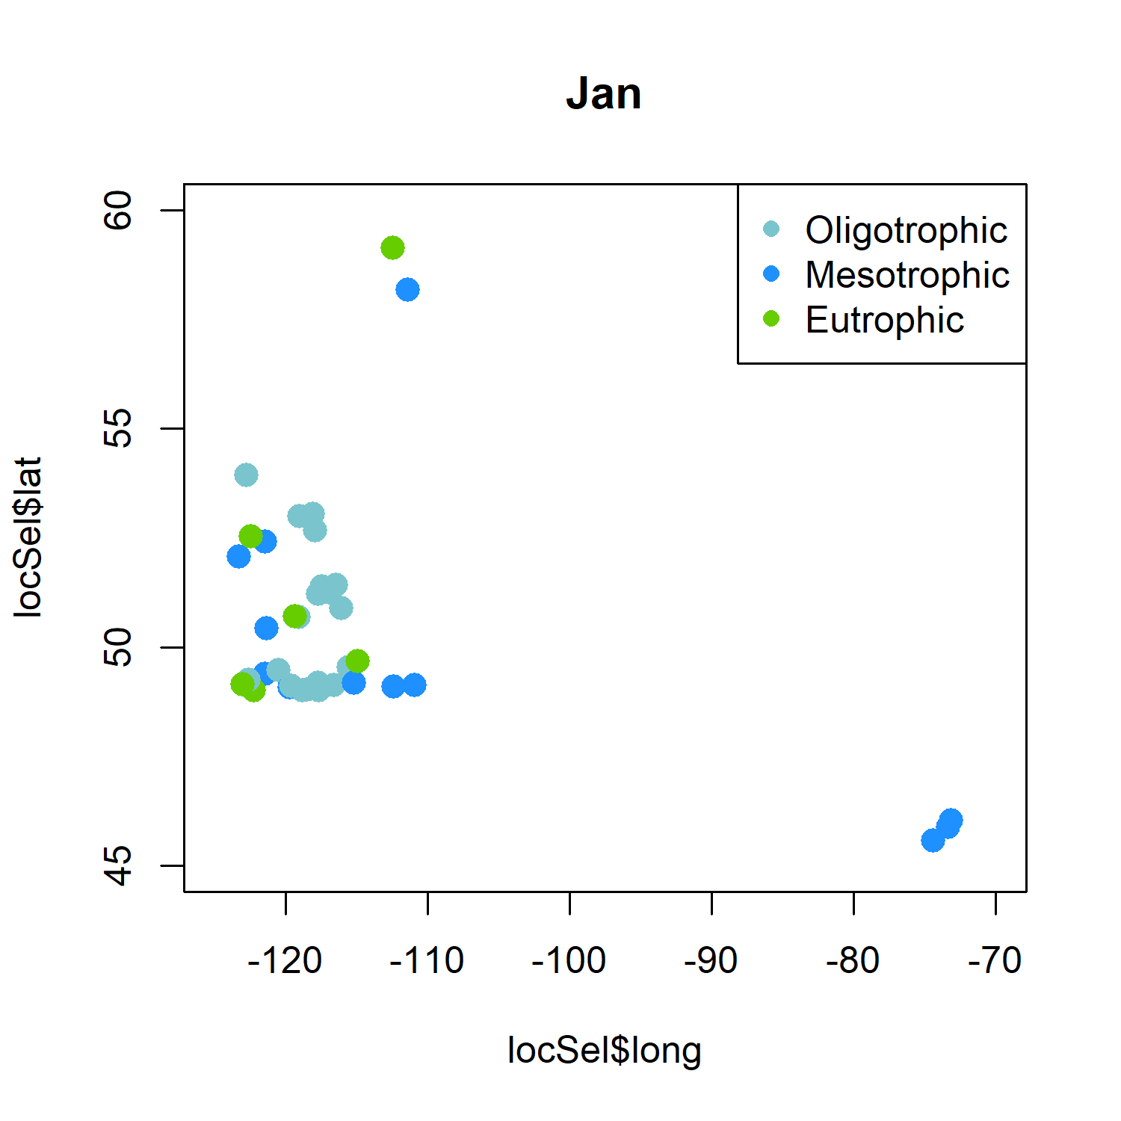

Slide 27
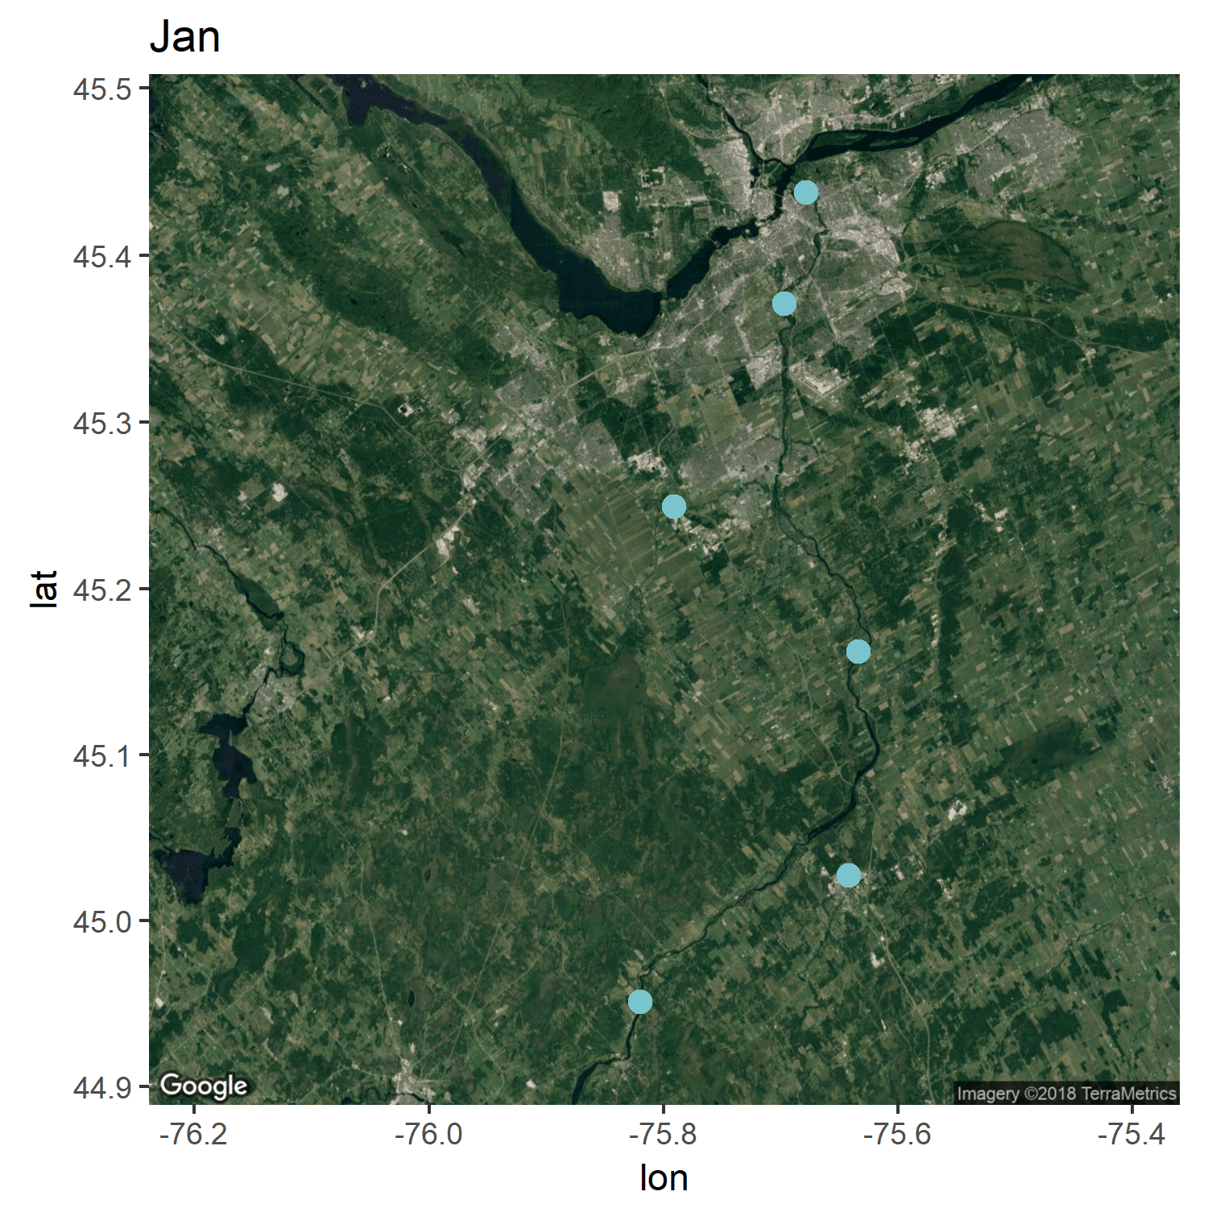

Slide 28

Sur le terrain, il existe une forte corrélation entre les différents aspects de la qualité de l’eau

Slide 29
Sur le terrain, il existe une forte corrélation entre les différents aspects de la qualité de l’eau
Existe-t-il des métriques simples permettant de quantifier ou un lac ce situe dans cette espace?

Slide 30
Sur le terrain, il existe une forte corrélation entre les différents aspects de la qualité de l’eau
Existe-t-il des métriques simples permettant de quantifier ou un lac ce situe dans cet espace?
La vulnérabilité peut être évaluée en utilisant la probabilité d’un lac de bouger dans cet espace

Slide 31
La vulnérabilité de la qualité de l’eau
Agriculture
Magnitude
Mining
Risque
Changements Climatiques

Slide 32
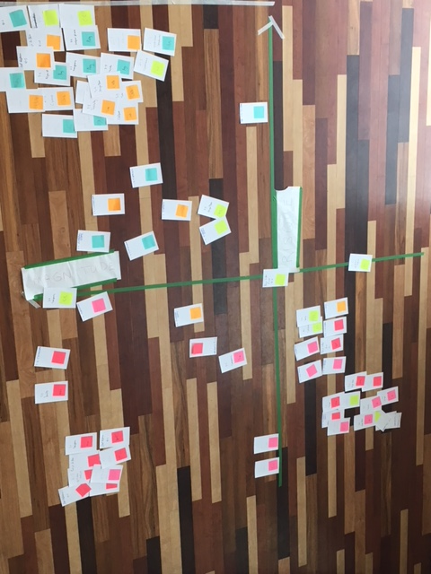
La vulnérabilité de la qualité de l’eau
Agriculture
Magnitude
Urbanisation
Risque
Changements Climatiques

Slide 33
La vulnérabilité de la qualité de l’eau
Agriculture
Magnitude
Mining
Risque
Changements Climatiques

Slide 34
La vulnérabilité des lacs canadiens
Agriculture
Magnitude
Mining
Risque
Changements Climatiques

Slide 35
La vulnérabilité des lacs canadiens
Agriculture
Magnitude
Mining
Risque
Changements Climatiques

Slide 36



Partenaires
Remerciments
Morgan Botrel, Lisa Galantini, Stepanie Shousha, Jeremy de Bonville, Charles Charrier Tremblay, Christophe Benjamin
l’équipe de PercoLab
Les participants à l’atelier

Slide 37
Quelles variables explique le dépassement des critères
Trophic Status
Drinking
Livestock
TN
77%
TP
91%
Arsenic
65%
Lead
84%
Cadmium
5%
Uranium
5%
Arsenic
95%
Lead
22%
Recreational
Irrigation
Aquatic Wildlife
Fecal cont.
100%
Fecal cont.
100%
Dicamba
100%
Lead
60%
Cadmium
76%
Arsenic
1%

Slide 38
Quelles variables explique le dépassement des critères
Trophic Status
Drinking
Livestock
TN
77%
TP
91%
Arsenic
65%
Lead
84%
Cadmium
5%
Uranium
5%
Arsenic
95%
Lead
22%
Recreational
Irrigation
Aquatic Wildlife
Fecal cont.
100%
Fecal cont.
100%
Dicamba
100%
Lead
60%
Cadmium
65%
Arsenic
6%
Chloride
43%
Chloride
18%
Fluoride
53%
Iron
53%

Slide 39
Ecosystem services
Causation
Trophic status
Ecosystem Functions
Synthetic Chemicals
Microcystin > x
Ecological processes
Ecotoxological world view
Integrator
Trophic status
Not drinkable
Drinkable
Ecological world view

Slide 40
Canadian River DBs
20 DBs
Guidelines DB
Canadian guidelines for the selected ES and trophic status
Function XX
Aggregated limnological DB
Measures of the selected compounds in Canadien Rivers
61 000 sampling events on X years

Slide 41
